Slide 1



Local
Container
Input data
Like CLM input
inputfolder
$CESMDATAROOT/inputdata
Hist output data
Only land
outputfolder
$CESMDATAROOT/Archive/lnd/hist
Scripts
Bash scripts
Cases
scriptsfolder
/p/scripts
Log
Case log
Cases output
logfolder
$CESMDATAROOT/CaseOutputs

Slide 2

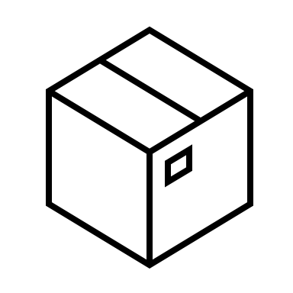

pyclmuapp
Pull image
Run container
Run case
Get results
Create forcing
Create surface
…
CLMU-App
CLM ENV
CLM >
(hosted by NCAR)
GitHub: https://github.com/ESCOMP/CTSM
Run CLM/CTSM in container
CLMU
./create_case …
./xmlchange …
…
./case.build
./preview_namelists
./case.submit
Linux
Mac
Win
AMD
64
ARM
64

Slide 3
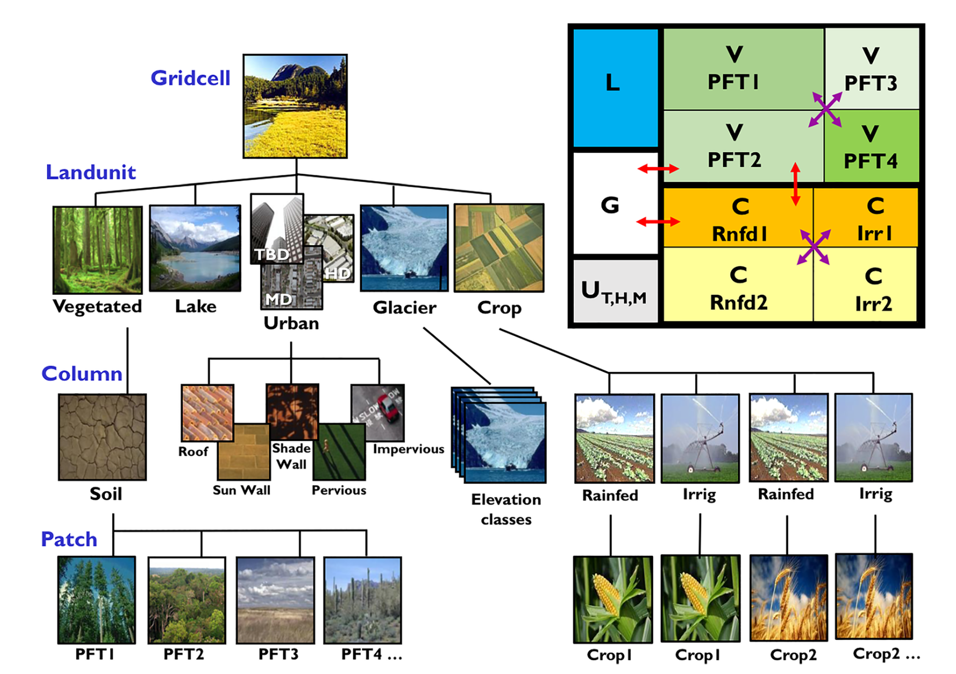
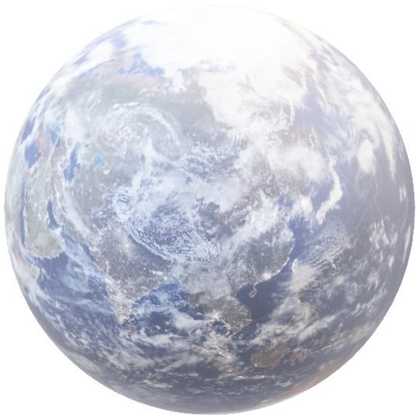

Slide 4
CLMU-App
1 Pull image
> docker pull envdes/clmu-app:1.0
2 Run container
> docker run --hostname clmu-app --name ContainerName -it envdes/clmu-app:1.0
3 Configuration and run
> cd $CASESCRIPT
> ./create_newcase ..
> ./xmlchange …
> ./case.setup
> ./case.build
> ./case.submit
Follow the instruction of CLM5.0 single point simulation

Slide 5
Python
1 Initialize
from pyclmuapp import usp_clmu
usp = usp_clmu( pwd=os.getcwd(), container_type='docker’)
usp.docker("run")
2 Input
usp.check_surf(usr_surf ="surface.nc")
usp.check_forcing(usr_forcing="forcing.nc")
3 Configuration and run
usp_res = usp.run(
case_name = ”usp",
RUN_STARTDATE = "2012-01-01",
STOP_OPTION = "nyears", STOP_N = "2”, …)
# usp_res will return a list of result files location.
4 Finalize
usp.docker("stop")
usp.docker("rm")

Slide 6

CLM
Land model component
CESM Component
Soil
Hydrology
…
Urban
…
ATM
LND
OCN
ICE
…
Grid cell
CLMU
lat
lon
CESM
Radiation
Turbulent fluxes
Building energy
Hydrology
roof
wall
roof
pervious road
impervious road
Urban canyon

